Slide 2
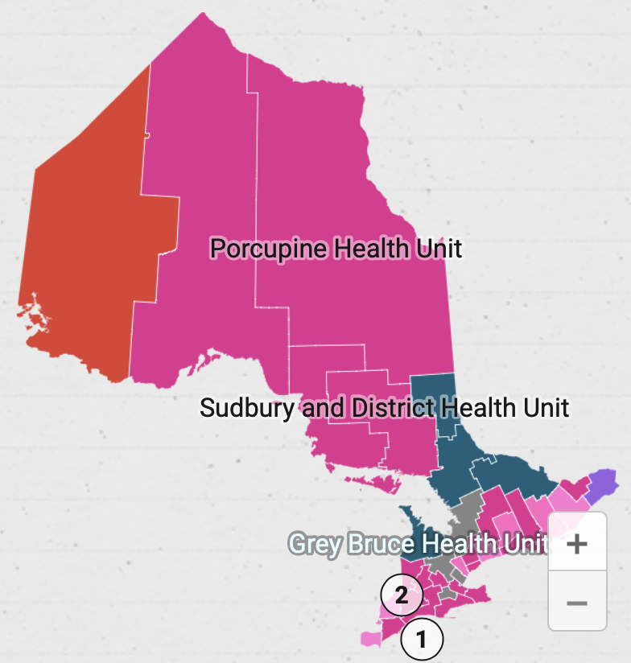
Public Health in CUPE
CUPE represents about 5,000 public health workers across 25 of the 34 Public Health Units in Ontario.
Visit: https://cupe.on.ca/committees/public-health-workers/ to view interactive maps
Notes:
CUPE represents roughly 5,000 public health workers.
We are a small but mighty group!
These workers are spread across 25 of the 34 public health units in Ontario.

Slide 3
Public Health in CUPE
CUPE Ontario
290,000 members
OMW Ontario Municipal Workers
90,000
Public Health Subsector
5,000
Health Care Sector
60,000
School Board Sector
55,000
University Sector
30,000
Social Services Sector
30,000
Notes:
CUPE Ontario is the political wing of the CUPE, Canada’s largest union.
With over 290,000 members, CUPE Ontario is a strong voice for rights and fairness for our members and our communities. We work at the provincial level for legislative, policy and political change on issues affecting public services, equality, healthy communities and a better Ontario for everyone.
Our leaders are elected at our convention by delegates selected by member locals. At Convention, we also democratically decide on our political action. Locals choose to join CUPE Ontario because of the strong voice we have collectively, and because of our history of advocacy. We are very proud that the vast majority of locals in Ontario have chosen to affiliate to CUPE Ontario.
Across the province, our members work in five main sectors: Municipal, Health Care, Social Services, School Board, and University sector.
In the past, public health workers have been shifted between the Municipal and Health Care sectors, but most recently we have carved a permanent spot in CUPE Ontario structure by becoming a subsector of OMW

Slide 4
Public Health in CUPE
CUPE Public Health Survey brought to light pandemic challenges faced by public health workers.
At OMECC/OMW Conference in 2023 we came together to overcome internal barriers to organizing and voted for a new subsector for Public Health Workers.
We now have vote and voice at CUPE Ontario Municipal Workers (OMW) table
Notes:
Goals of the CUPE public health survey were to:
Assess workers’ economic and mental well-being, job satisfaction and morale with emphasis on the pandemic experience
Rating of key sector challenges for strategic planning for the sector
Priorities ranked by the survey
Collective bargaining to raise our wages and improve working conditions
Educating the public on the importance of public health workers
Political action to increase funding and oppose privatization and mergers
Raising the profile of public health workers in CUPE

Slide 5
Public Health in CUPE
In 2024 a Public Health Worker sub-committee was elected within the Ontario Municipal Workers (OMW) sector as part of CUPE Ontario’s efforts to support members working in Public Health.
Notes:
Goals/Objectives:
We are a diverse workforce, and all classifications are important to Public Health as a whole.
Educating union members, government officials, and the public about the importance of public health and its diverse workforce is crucial.
Highlighting the vital roles public health workers play in preventing disease and promoting wellness, ensuring better policies, and resources to improve community health outcomes in a cost-effective manner.
Build Solidarity:
Create a network of communication with Locals and Bargaining Units under Public Health to share tools to better communicate their needs with their Employer and government leaders.
Build Connections:
Make everyone feel like they belong, connectiveness and understanding.
By fostering a strong network among public health workers, the CUPE Public Health Committee ensures that there is a unified voice addressing common concerns and needs. This collective approach enhances communication, support, ad collaboration, leading to more effective public health outcomes for communities across Ontario.
Voice public health workers within CUPE for issue we face to steer our organization and the government at large, strength of diversity, work together, support members that are greater wage equity. Equality of equity, respect.
Foster a work environment that promotes each worker as an equally valued member.
Partner with other CUPE groups with overlapping interests to build a louder voice in our communities.
Build resources to help find sympathetic government leaders to advocate in higher levels of government.

Slide 6
Public Health in CUPE
Meet the Public Health Committee 2024-2026
Merima Kostecki L1559 Leeds Grenville and Lanark District Health Unit
Crystal Cook L905 York Public Health
Anya Besharah L1916 Sudbury Public Health
Leah Murphy L543 Windsor Public Health
Kim Curran L1602 Haliburton KPR Health Unit
Pam Pressic L4170 Peterborough Public Health
Michelle Eagle L966 Peel Region Public Health

Slide 7
Public Health in CUPE
“Fostering a strong network among public health workers, the CUPE Public Health Committee ensures that there is a unified voice addressing common concerns and needs. This collective approach enhances communication, support, and collaboration, leading to more effective public health outcomes for communities across Ontario.”
Notes:
Goals/Objectives:
We are a diverse workforce, and all classifications are important to Public Health as a whole.
Educating union members, government officials, and the public about the importance of public health and its diverse workforce is crucial.
Highlighting the vital roles public health workers play in preventing disease and promoting wellness, ensuring better policies, and resources to improve community health outcomes in a cost-effective manner.
Build Solidarity:
Create a network of communication with Locals and Bargaining Units under Public Health to share tools to better communicate their needs with their Employer and government leaders.
Build Connections:
Make everyone feel like they belong, connectiveness and understanding.
By fostering a strong network among public health workers, the CUPE Public Health Committee ensures that there is a unified voice addressing common concerns and needs. This collective approach enhances communication, support, ad collaboration, leading to more effective public health outcomes for communities across Ontario.
Voice public health workers within CUPE for issue we face to steer our organization and the government at large, strength of diversity, work together, support members that are greater wage equity. Equality of equity, respect.
Foster a work environment that promotes each worker as an equally valued member.
Partner with other CUPE groups with overlapping interests to build a louder voice in our communities.
Build resources to help find sympathetic government leaders to advocate in higher levels of government.

Slide 8
Public Health in CUPE
Strategic priorities for the Public Health Committee
Education about what we do and the challenges we face
Engagement with public health locals across the province to build connections and capacity
Advocacy on the provincial level within CUPE and the government

Slide 9
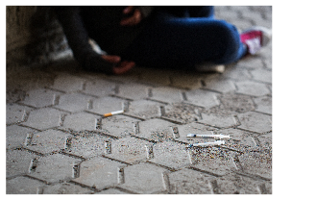
Public Health Workers
Notes:
Roles include:
Public Health Inspectors
Dental Hygienists and Assistants
Health Promoters
Family Home Visitors
Public Health Nurses
Smoke Free Ontario Inspectors
Nutritionists
Epidemiologists
Administrative Assistants
And many more...

Slide 10
Funding Challenges
Over the last 20 years there has been significant underfunding of Public Health.
Notes:
Over the last 20 years there have been significant underfunding at provincial and municipal levels.
Consequences:
Service cuts
Layoffs
Increased workloads
Wages not keeping up with cost of living
Stress and burn out

Slide 11
Funding Challenges - Mergers
Four voluntary mergers are in the process of being approved by the province. Merger deadline January 1, 2025
Porcupine / Timiskaming
Leeds Grenville Lanark / Kingston FL&A / Hastings PE
Peterborough / Haliburton KPE
Haldimond Norfalk / Brandt
Mergers bring uncertainty regarding potential effects on jobs and services to the community.

Slide 12
The Bottom Line
Public Health:
Transforms data into action, predicting concerns in communities before they become a problem.
Follows provincial standards with focus on local needs.
Are partners within our communities … working for everyone … people strong … CUPE Strong!
Notes:
CUPE public health workers are essential but have been undervalued by the Ontario government
Public health transforms data into action … keeping us safe by predicting concerns in communities before they become a problem. Health units and regional health departments follow provincial standards but are focused on local needs. They are partners in your community … working for you … people strong … CUPE strong.

Slide 13
Essential and Undervalued
CUPE Public Health workers are essential and have been undervalued by the Ontario government.
We need to raise our voices and build a campaign together to increase funding for our sector, our work, our jobs!
Because
Public Health Matters
Notes:
CUPE Public Health workers are essential but have been undervalued by the Ontario government.
We need to raise our voices and work to increase funding before it’s too late

Slide 14
The Challenge
To increase awareness of Public Health and the positive impact we have on our communities with:
Community partners
Local politicians
Provincial politicians
The general public

Slide 15
The Challenge
Differentiate Public Health from healthcare by:
Increasing understanding of how Public Health reduces pressure on the healthcare system
Improving lives both locally and provincially
Saving money by preventing illness and injury

Slide 16
The Challenge
Highlight the risk to Public Health from:
Only a 1% increase in funding which equals cuts to services
Chronic underfunding for over two decades that cripples effective health promotion and prevention efforts
Increasing pressures from continued outbreaks and demands of provincial mandates (OPHS)
Work that’s not being done due to budget constraints puts the public’s health at risk.

Slide 17
The Campaign
Because Public Health Matters
Increase awareness of Public Health with:
Health unit staff
Community partners
Boards of Health
Municipal politicians
Provincial politicians
General public
Notes:
The campaign is designed to be a series of toolkits that your local can mix, match and update to meet your needs depending on the audience that you feel would work best for your local efforts

Slide 18
The Campaign
Because Public Health Matters
Weather you are a small public health local or a composite local, your members can benefit from a campaign.
Because Public Health Matters is a provincial campaign that can be utilized as is, it comes with a toolkit, or it can be customized to suit your local needs.
Cost-share with CUPE National is available to offset local campaign costs.

Slide 19
The Campaign
Toolkit for Public Health Staff:
Posters, flyers for CUPE bulletin boards, information booths
PowerPoint and email templates for member communication
Public campaign webpage to send an auto email to local politicians
Swag – flags, t-shirts, signs

Slide 20
The Campaign
Toolkit for Community Partner, Local Politicians and Boards of Health:
Social Media creative that includes; messages, images, graphics and video along with public campaign web page
Direct letter/email samples for community partners, local municipal councilors
Deposition guide for BOH and/or county councils with presentation template

Slide 21
The Campaign
Toolkit for Media:
Local CUPE resolution to support ‘Because Public Health Matters’ campaign with link to public campaign web page
Sample press release and email template
Social media artwork
Videos

Slide 22
The Campaign
Toolkit for General Public:
Posters, flyers for information booths/pickets
Links to public facing campaign website with an opportunity for people to auto send an email to their local politicians
Social media artwork
Videos

Slide 23
Getting Involved
Visit the Public Health Worker’s campaign web page where you can find:
Information on how to apply for campaign funding from CUPE National
Toolkit material like depositions, presentations and emails you can download, customize and use for your campaign
Social media artwork and videos you can post
Notes:
The size of your local does not matter, if you are part of a composite local or an autonomous local, we can all do our part to raise the profile of Public Health in our area.
Visit our home on the web for Public Health Workers - https://cupe.on.ca/committees/public-health-workers/ where you can find:
Information on how to apply for campaign funding from CUPE National
Toolkit material you can download, customize and use as part of your local campaign

Slide 24
Getting Involved
Email the CUPE Public Health Workers sub-committee at:
phchairomw@gmail.com
publichealthomw@gmail.com

