Slide 1
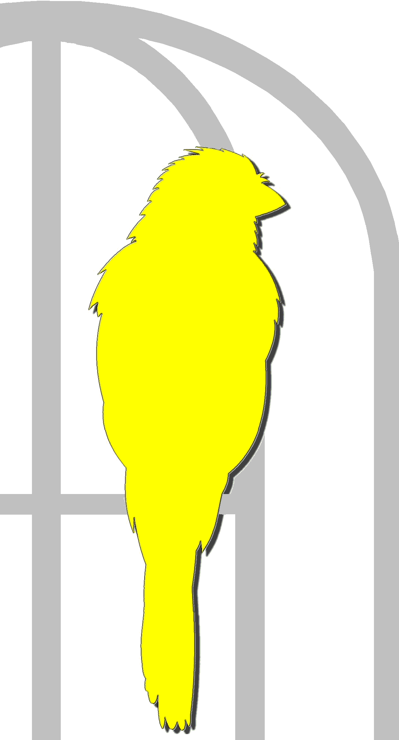
How Violence Impacts our Mental Health at Work Jenna Brookfield CUPE Health & Safety Representative

Slide 2
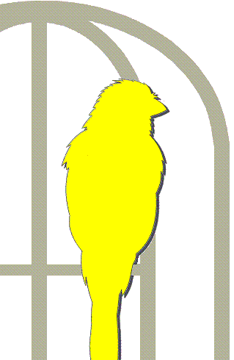
Two Perspective
Violence targeting our mental health
Mental health impacts of physical violence
Notes:
2

Slide 3
How we Define Violence
Type I: Violent acts by criminal outsiders who have no other connection with the workplace but enter to commit robbery or another crime.
Type II: Violence directed at employees by customers, clients, patients, students, inmates, or any others for whom an organization provides services.
Notes:
3

Slide 4
How we Define Violence
Type III: Violence against coworkers, supervisors, or managers by a present or former employee.
Type IV: Violence committed in the workplace by someone who doesn't work there but has a personal relationship with an employee—an abusive spouse or domestic partner.
Notes:
4

Slide 5
What about Psychological Violence?
Intent to cause harm and includes:
Harassment
Bullying
Discrimination
Violence targeted at our mental and emotional wellbeing
Notes:
5

Slide 6
Impacts of Psychological Violence
Shock
Anger
Feelings of frustration and/or helplessness
Increased sense of vulnerability
Loss of confidence
Physical symptoms such as:
Inability to sleep
Loss of appetite
Psychosomatic symptoms such as:
Stomach pains
Headaches
Panic or anxiety, especially about going to work
Family tension and stress
Inability to concentrate
Low morale and productivity

Slide 7
Terminology
Mental Illness - A medical condition that affects a person’s thoughts, behavior and mood. For example: depression, schizophrenia, anxiety disorder, and eating disorders. They can take many forms and are treatable.
Mental Injury - Injury to your mental health caused by your work environment and conditions. An injury can take the form of a mental distress or even lead to a mental illness.
Notes:
7

Slide 8
Mechanism of Injury
Stress
When you encounter a perceived threat — a large dog barks at you during your morning walk, for instance — your hypothalamus, a tiny region at the base of your brain, sets off an alarm system in your body. Through a combination of nerve and hormonal signals, this system prompts your adrenal glands, located atop your kidneys, to release a surge of hormones, including adrenaline and cortisol.
Good stress - related to circumstances in your control
Bad stress - you have no control over the stimuli triggering the stress
Notes:
8

Slide 9
Perspectives on Stress
Its not stress that kills us, it is our reaction to it.
Many of us feel stress and get overwhelmed not because we're taking on too much, but because we're taking on too little of what really strengthens us.
Adopting the right attitude can convert a negative stress into a positive one.
Notes:
9

Slide 10
Resilience Training
It is becoming increasingly difficult for trade unionists to keep the attention of employers focused on prevention when these employers are being bombarded with “experts” who are telling them that their problem is the lack of resilience in their workers and that this can be fixed by training managers, or their workers. - http://www.hazards.org/stress/resilience.htm#checklist
Notes:
10

Slide 11
Employer’s are buying into resiliency training
Examples of advice on how to reduce stress:
Eat, sleep, and relax as usual.
Exercise to relieve stress.
Don't use chemicals to enhance performance or induce rest.
Talk with friends and supporters about things that are heavy on your heart. (In health care, though, be careful not to violate a patient's privacy.)
Journal, blog, tweet, send email to a friend. Pray, meditate, have a small group discussion with others who care. (Don't forget patient privacy.)
Write about or share one good thing each day.
Look for lessons to be learned from even the worst situations.
Celebrate even small victories and personal accomplishments.
Notes:
11

Slide 12
What’s Missing?
Prevention
Notes:
12

Slide 13
Psychosocial Hazards
Mental injuries are caused by exposure to Psychosocial Hazards
Assessment tool developed by the Centre for Applied Research in Mental Health and Addiction (CARMHA)
13 Psychosocial Factors
Psychological & Social Support | Civility & Respect | Recognition & Reward
Clear Leadership & Expectations | Organizational Culture | Growth & Development
Psychological Competencies & Requirements | Psychological Protection | Protection of Physical Safety
Workload Management | Engagement | Balance
Involvement & Influence
Notes:
13

Slide 14
Mental Health Impacts of Physical Violence
Jane Doe – CUPE member working in Long Term Care
Same employer for 23 years
New Administration decided to designate the faculty as a “stabilization” facility for additional funding
Funding was redirected to expanding the facility (more beds, more $)
Staff now working with “complex” clients (increased violence)
No additional training or staffing
Large increase in workload due to complexity of clients
Strict task deadlines imposed on staff
Notes:
14

Slide 15
Mental Health Impacts of Physical Violence
On her 22nd year of employment she experienced her 1st assault at work, and her 2nd…and her 7th which resulted in broken bones and a severe concussion
Took her concerns to her supervisor - was told “this is the job now. Maybe its not the right place for you”
Used to be a “team” at work where they supported one another
As workload grew so did the distance between coworkers
The once cohesive work unit started to experience more complaints of bullying and harassment among staff
As staff concerns increased ER offered in-services on violence prevention – that were optional and unpaid
Notes:
15

Slide 16
Mental Health Impacts of Physical Violence
More injuries and Workers Comp Claims
Many senior staff start leaving for other jobs or retiring
More sick calls
Working short on most shifts
Staff “mandated” to work double shifts
Exhausted from work – starts to impact family relationships
Notes:
16

Slide 17
Psychosocial Hazards
Mental injuries are caused by exposure to Psychosocial Hazards
Assessment tool developed by the Centre for Applied Research in Mental Health and Addiction (CARMHA)
13 Psychosocial Factors
Psychological & Social Support | Civility & Respect | Recognition & Reward
Clear Leadership & Expectations | Organizational Culture | Growth & Development
Psychological Competencies & Requirements | Psychological Protection | Protection of Physical Safety
Workload Management | Engagement | Balance
Involvement & Influence
Notes:
17

Slide 18
Psychological & Social Support
Refers to the degree of social and emotional integration and trust among co-workers and supervisors.
Took her concerns to her supervisor - was told “this is the job now. Maybe its not the right place for you”
Used to be a “team” at work where they supported one another
As workload grew so did the distance between coworkers
Notes:
18

Slide 19
Organization Culture
Organizational Culture : the degree to which a work environment is characterized by trust, honesty, and fairness.
Strict task deadlines imposed on staff
Administration decided to designate the faculty as a “stabilization” facility for additional funding
Took her concerns to her supervisor - was told “this is the job now. Maybe its not the right place for you”
Notes:
19

Slide 20
Civility & Respect
Civility & Respect as present in a work environment where employees are respectful and considerate in their interactions with one another. Civility and respect are based on showing esteem, care and consideration for others, and acknowledging their dignity.
Used to be a “team” at work where they supported one another
As workload grew so did the distance between coworkers
The once cohesive work unit started to experience more complaints of bullying and harassment among staff
Notes:
20

Slide 21
Clear Leadership & Expectation
There is support that helps employees know:
• What they need to do
• Concerned with long-term objectives
• Transmit a sense of mission, vision and purpose
• Give individualized consideration to their employees
Administration decided to designate the faculty as a “stabilization” facility for additional funding
No additional training or staffing
Strict task deadlines imposed on staff
Notes:
21

Slide 22
Psychological Demands
Psychological demands are documented and assessed in conjunction with the physical demands of the job. Assessments consider time stressors, breaks, incentive systems, job monotony and repetition and type of work.
No additional training or staffing
Strict task deadlines imposed on staff
Large increase in workload due to complexity of clients
Notes:
22

Slide 23
Growth & Development
Employees receive
• Encouragement and support in the development of their interpersonal, emotional and job skills
• Internal and external opportunities to build competencies
– That will help with current jobs, and
– Also prepare them for possible future positions
No additional training or staffing
As staff concerns increased ER offered in-services on violence prevention – that were optional and unpaid
Notes:
23

Slide 24
Recognition & Reward
Acknowledgement and appreciation of employees’ efforts provided in a fair and timely manner:
– Appropriate and regular feedback
– Team celebrations, recognition of years served, and/or milestones reached
Nothing
Notes:
24

Slide 25
Involvement & Influence
Employees included in discussions about how their work is done and how important decisions are made.
New Administration decided to designate the faculty as a “stabilization” facility for additional funding
Funding was redirected to expanding the facility (more beds, more $)
Staff now working with “complex” clients (increased violence)
No additional training or staffing
Large increase in workload due to complexity of clients
Notes:
25

Slide 26
Workload Management
A work environment where assigned tasks and responsibilities can be accomplished successfully with the time available
Staff now working with “complex” clients (increased violence)
No additional training or staffing
Large increase in workload due to complexity of clients
Strict task deadlines imposed on staff
Working short on most shifts
Mandating double shifts
Notes:
26

Slide 27
Engagement
Engagement as present in a work environment where employees feel connected to their work and are motivated to do their job well. Employee engagement can be physical, emotional and/or cognitive.
Many senior staff start leaving for other jobs or retiring
Notes:
27

Slide 28
Balance
Balance as present in a work environment where there is recognition of the need for balance between the demands of work, family and personal life.
Staff “mandated” to work double shifts
Exhausted from work – starts to impact family relationships
Notes:
28

Slide 29
Psychological Protection
Workplace psychological safety is demonstrated when workers feel able to put themselves on the line, ask questions, seek feedback, report mistakes and problems, or propose a new idea without fearing negative consequences to themselves, their job or their career.
Took her concerns to her supervisor - was told “this is the job now. Maybe its not the right place for you”
Notes:
29

Slide 30
Protection of Physical Safety
Protection of Physical Safety as present in a work environment where management takes appropriate action to protect the physical safety of employees. Appropriate actions may include: policies to protect employees’ physical safety; training in safety-related protocols; rapid and appropriate response to physical accidents or situations identified as risky; and clearly demonstrated concern for employees’ physical safety.
Staff now working with “complex” clients (increased violence)
No additional training or staffing
On her 22nd year of employment she experienced her 1st assault at work, and her 2nd…and her 7th which resulted in broken bones and a severe concussion
More injuries and Workers Comp Claims
Notes:
30

Slide 31
What can we do?
Civility & Respect
Organization Culture
Notes:
31

Slide 32
What can we do?
Begin changing the organizational culture to value civility and respect
Leaders (no title required) can have a huge impact on culture by modeling behaviour
Notes:
32

