Slide 1
Domestic violence:
A workplace health & safety concern
CUPE ONTARIO
Health & Safety/Injured Workers Conference
October 27th, 2016

Slide 2
Why a trade union issue?
Domestic violence:
Widespread
  without doubt many CUPE members are affected
Deeply impacts workers’ lives and work
Can affect job performance
  therefore job prospects and security
Threatens health and safety
  Victims/survivors & coworkers
  Offenders & coworkers
Can threaten lives

Slide 3
Why a trade union issue?
Victims/survivors may be at increased risk of harm in their workplace if they leave an abusive partner
  Work may be the only place where they can be located
Employers who are aware of domestic violence and fail to protect their employees from violence at work may be held liable under health and safety legislation
  Joint OHS Committees can help to ensure compliance with Ontario legislation

Slide 4
Occupational Health & Safety Act
Domestic violence is considered workplace violence under the terms of the Ontario OHSA
Under section 32.0.4 of the Act
  if an employer is aware or ought to be aware that domestic violence that is likely to expose a worker to physical injury may occur in the workplace, the employer must take every reasonable precaution to protect the worker
Notes:
Trainer Note: Click to the next slide to highlight the language

Slide 5
What do we know about domestic violence and its impacts on workers and the workplace?

Slide 6







Slide 7
Who took part?
8,429 total respondents
78.4% female
49.8% Ontario, 21.6% BC
94.1% between 25 and 64 years
81.1% permanent employment
81.4% unionized (in current or last job)
Over half from educational or healthcare/social assistance sectors

Slide 8
Definition
For this survey, domestic violence was defined as any form of physical, sexual, emotional or psychological abuse, including financial control, stalking and harassment. It occurs between opposite- or same-sex intimate partners, who may or may not be married, common law, or living together. It can also continue to happen after a relationship has ended.
(Schmidt, 2012)

Slide 9
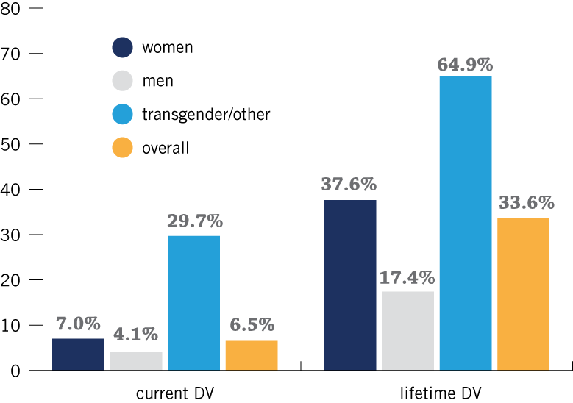
DV Prevalence

Slide 10
DV prevalence
One third (33.6%) had experienced DV in their lifetime
Female, transgender, and Aboriginal respondents, those with disabilities, or a sexual orientation other than heterosexual had higher rates
Rates consistent with other large surveys

Slide 11
Workplace Impact
Among those who experienced DV…
38%
reported that DV affected their ability to get work

Slide 12
Getting to Work
“I would have to find a safe house because of violence at night. Then I would be without work clothing or school uniforms for the kids. My children and I would be too emotionally upset to go to work and school the next day.”
“Sleep deprivation affected [my] ability to focus at work or get there on time.”
“I ended up taking a lot of time off and for the most part no one really understood exactly why I was gone for so long.”
“[I] lied about injury and absence due to fear and not able to admit to abuse at that time.”

Slide 13
Workplace Impact
Among those who experienced DV…
53.5%
experienced DV at or near the workplace

Slide 14
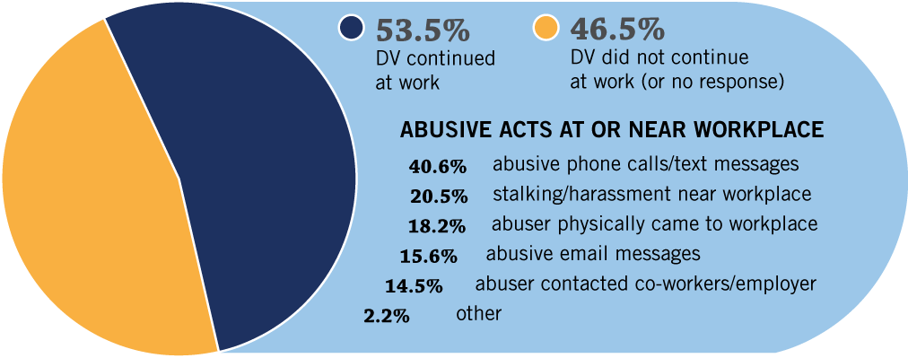
DV at the Workplace

Slide 15
DV at the Workplace
“Constant phone calls prevented me from doing my job properly, as it tied up the phone required for business.”
“He pretended to be security and dragged me out of work.”
“[The abuser] would phone my workplace to see what time I had left, and phoned when I arrived to make sure I was actually going to work.”
“My ex-husband threatened to call my employer to tell them lies about me.”

Slide 16
Workplace Impact
Among those who experienced DV…
81.9%
found that DV negatively affected their work performance

Slide 17
Results – DV & Workplace Impacts
Impacts
Negative Impacts:
  distracted (66%; e.g., by stress, abusive emails etc.)
  tired (62.1%; due to sleep deprivation from the DV)
  unwell (62.0%; anxiety, depression, headache from DV)
  injured (16%; from the DV)

Slide 18
Negative Impact on Performance
“I was tired and distracted yet work was a place where I felt safe.”
“...there’s no doubt it had impact, but I took pride in my ability to stay focused and on task with a professional presentation. However, those were very difficult times.”
“Dealing with my ex-husband left me feeling anxious, tired due to lack of sleep. It affected the pleasure my work usually gives me.”

Slide 19
Concerns
Warning signs?
Risk factors?
Health & Safety concerns?

Slide 20
What Do Co-Workers See?
35.4%
reported having at least one co-worker they believe is experiencing, or has previously experienced, DV
11.8%
reported having at least one co-worker who they believe is being abusive, or has previously been abusive toward a partner

Slide 21
Co-Workers
Among those who experienced DV…
37.1%
reported co-workers affected by their DV too

Slide 22
Impact on Co-Workers
“People were sympathetic and horrified, but also very, very uncomfortable…”
The domestic violence caused unease between me and my co-workers because I had to miss work or sometimes cried. Also, some people felt helpless; they would have liked to intercede, but did not dare for fear of endangering me or themselves.”
“I could see how my situation could place others in danger and was lucky that none of the threats were brought forth or followed up.”

Slide 23
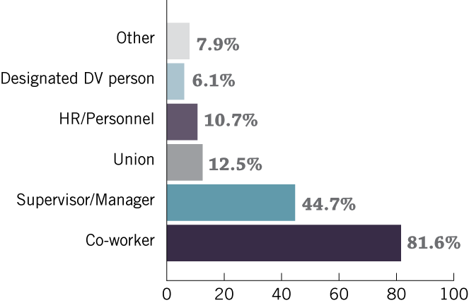
Workplace Support
43.3% of those experiencing DV discussed it with someone at work

Slide 24
Outcome of disclosure
Why people don’t disclose:
  Embarrassment/shame/judgment
  Privacy/ ‘none of their business’
  Didn’t want to get others involved

Slide 25
Workplace Support
“…confiding in co-workers helped alleviate the stress of being attacked going to the car, the unending phone calls over and over and over and the extreme fatigue both physically and mentally.”
“The support from the few co-workers and the employer Psychologist was empowering. The gossip was malicious and not at all helpful.”
“People just knew, I was ashamed, they didn’t have much respect for me.”

Slide 26
Providing Information
Workers received info about DV from:
28% employer
27% union

Slide 27
Providing Information
“… we bring to work everything that happens at home. We can't compartmentalize or mentally separate these different aspects of our lives. While it might not technically be the responsibility of the employer or union to provide shelter or assistance for employees being victimized by abusers at home, the workplace is a logical place to provide help, support, and resources for victims of violence.”
“I think creating the ability in the union and in any work environment for discussions around these issues is more important than people realize.”

Slide 28
Perceived Workplace Support
10.6%
think that employers are aware when DV is affecting their workers
  of those 62.3% think employers act positively

Slide 29
Perceived Workplace Support
11.3%
think that union officials are aware when DV is affecting members
  of those 86.6% think unions act positively

Slide 30
Workplace Support
“I was extremely nervous about sharing my situation... understanding that it may have a negative impact on how my supervisor viewed me and my work. However, that was unfounded and so far they have been very helpful and understanding and have also respected my privacy and been careful not to intrude.”

Slide 31
Workplace Support
“There are some co-workers who will listen; however most don’t really want to get involved. The only concern my boss had was how soon was I going to return to work.”
“My employer simply said to me, take whatever time you need and if you need any help with anything just let me know. I was very fortunate to have such an understanding and flexible employer.”

Slide 32
Workplace Impact
Among those who experienced DV…
8.5% lost a job due to DV

Slide 33
Job Loss
“I was in trouble for missing a lot of work and now I can’t miss work without a doctor’s note.”
“The only concern my boss had was how soon was I going to return to work.”

Slide 34
Beliefs about DV in the Workplace
91.5% (all respondents)
DV impacts the work lives of workers

Slide 35
Beliefs about DV in the Workplace
74.4% (all respondents)
Workplace supports such as paid leave and safety policies can reduce the impact of DV

Slide 36
Other key findings
DV is associated with poorer general health, mental health, and quality of life – but less so for those who are currently working (protective effect of work?)
Nearly 40% believed they have a co-worker who is/was a DV victim and/or perpetrator
  awareness of victimization was more common

Slide 37
Occupational Health & Safety Act
Domestic violence is considered workplace violence under the terms of the Ontario OHSA
Under section 32.0.4 of the Act
  if an employer is aware or ought to be aware that domestic violence that is likely to expose a worker to physical injury may occur in the workplace, the employer must take every precaution reasonable to protect the worker
Notes:
We are going to spend the balance of the day unpacking the legislation.

Slide 38

Workplace Warning Signs
Disruptive phone calls or visits from the partner
Obvious injuries
  bruises, black eyes, broken bones, hearing loss
  often attributed to falls, being clumsy or accidents
Hiding injuries
  Clothing inappropriate for the season (long sleeves & turtlenecks, sunglasses indoors)
  Changes in makeup or concealer
Absenteeism or lateness
Being the victim of vandalism or threats
Notes:
The first step into the workplace is to see how the warning signs may be different. In the workplace, DV often shows up first as performance issues.

Slide 39
Workplace Warning Signs
Job performance problems
  poor concentration, errors, slowness, difficulty making decisions, inconsistent work quality
Requests for special accommodations
  leave early, change schedule
Behaviour
  anxiety, emotional outbursts, tears, apprehension, withdrawal or social avoidance, excessive tiredness or depression
Lack of access to money

Slide 40
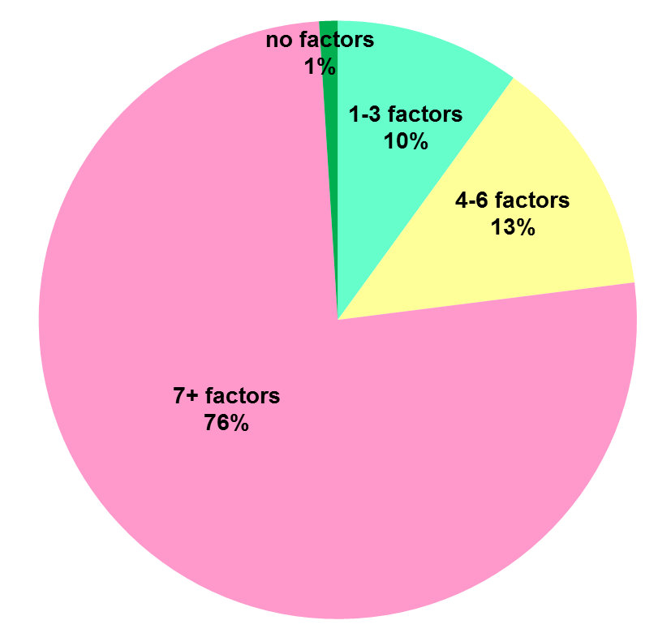
Risk Factors
  A history of domestic violence
  Actual or pending separation
  Obsessive behaviour
  Depression of the perpetrator
  The level of violence is increasing
  Prior threats / attempts of suicide
  Threat to kill
  Prior attempts to isolate victim
  Victim had intuitive sense of fear
  Perpetrator unemployed
*39 risk factors identified that indicate potential for lethality
DVDRC 2012 Report
40
Notes:
The DVDRC has identified 39 risk factors that indicate the potential of lethality. While warning signs are a red flag that should raise questions, these high risk factors, especially when they occur in combination, mean that you need to act. At the very least, you need to tell what you know to the people who are responsible for safety, possibly call police. Safety for everyone is the priority.

Slide 41
Increasing Risk
Perpetrators who extend their abuse to the work setting are increasing the number of domains in which they control their partners
By harassing, stalking, and threatening the target at work, offenders may succeed in getting the victim fired and thereby increase the victim’s dependence
(Farmer & Tiefenthaler, 1997; Gemignani, 2000, Reeves, O’Leary-Kelly, Farmer, Paetzold, & Tiefenthaler, 2001)

Slide 42

Tony McNaughton
January 29th 2000
Was stabbed to death whilst protecting a colleague from her estranged husband in Vancouver.

Slide 43

Aysegul Candir
December 10, 2004
Separated from her husband. He shot her in the parking lot of her workplace, Bramalee Secondary School. She later died in hospital.
Notes:
Asyegul Candir was a 47 year old Grade 10 teacher. She was separated, had hidden her whereabouts from her husband who had been out of the country when she fled the relationship. He knew to find her at work and he stalked her there. At one point he tried to enter the school but had been turned away by a student because he didn’t have authorization. Aysegul was shot several times in the parking lot outside Bramalea Secondary School by her former husband. Video surveillance showed later that he had been parked outside waiting for her to come out for some time. She later died in hospital.

Slide 44

Lori Dupont
November 5, 2005
Separated from her ex-partner, a doctor at the same hospital. He stabbed her in the operating room and later injected himself with a lethal dose. They both died.
Notes:
Asyegul Candir was a 47 year old Grade 10 teacher. She was separated, had hidden her whereabouts from her husband who had been out of the country when she fled the relationship. He knew to find her at work and he stalked her there. At one point he tried to enter the school but had been turned away by a student because he didn’t have authorization. Aysegul was shot several times in the parking lot outside Bramalea Secondary School by her former husband. Video surveillance showed later that he had been parked outside waiting for her to come out for some time. She later died in hospital.

Slide 45

Critical Events & Missed Opportunities
Dupont Inquest
84
37
Warning Signs
Opportunities
45
Notes:
This graph tells the tragic story of the murder of Lori Dupont. She was a nurse who was killed at Hotel Dieu Grace Hospital in 2005 by her ex-boyfriend, Dr. Marc Daniel.
The slide was presented by Dr. Peter Jaffe from the Centre for Research and Education on Violence against Women and Children at the Dupont Inquest. The blue shorter bars show the critical events, which are the warning signs that people witnessed. The tall purple bars show the missed opportunities for intervention. From the time of the first report in Oct 2003 until the time of her murder in Nov 2005, there were 37 critical events and 84 missed opportunities.
Ideally, we want to identify and respond effectively to situations at the low end of the graph. And we can see what happens when there is no interruption. Abusive behaviour will escalate without intervention. It does not always end in a murder but can mean years of suffering. Or the couple splits up and he goes to the next relationship and the pattern continues.

Slide 46
Offenders in the Workplace
The Co-workers’ perspective:
The most common impact on perpetrators
  difficulty with concentration or being distracted (30%)
  “unable to stay in the zone, always thinking about their spouse and the problems”
  “unable to focus”
This problem was often, but not always described alongside
  problems with work quality and productivity (26%)
  “Tendency to make mistakes by being distracted, then blames their home life for being the cause of their distraction.”
  “They don’t seem to be able to focus during the periods of abuse and then don’t get the job all done
(MacGregor et al, 2016)

Slide 47
Canadian Research on Offenders
P.I. Dr. Katreena Scott, OISE, University of Toronto
Aim: To examine the impact of DV perpetration on the workplace and consider workplace responses to this issue.
Survey of a sample of individuals attending intervention programs for DV perpetration
Recruited 500+ respondents from across Ontario
Survey data augmented with interviews of minority offender groups (e.g., women, same sex, linguistic minorities) and with employers
Preliminary data on 73 participants

Slide 48
Impacts
Ability to get to or stay at work (e.g., late, left early, missing days, lost job)
Performance (e.g., distracted, unwell)
Workplace safety

Slide 49
Impact: Performance
“My mood wouldn't be as upbeat. Very depressed. Emotionally hard to interact with people. Preferred working independently with minimal communication.”
“Loss of concentration, continuously thought about the circumstance. Feelings of regret and guilt.”
“Stress, court, programs cutting into work time 3 hours per week to help with courts and my life. A lot to take in.”
“Just trying to tell my boss I need a day off for my course, but not telling him what course.”
Notes:
Men are in PAR programs

Slide 50
Impacts: Safety
“Not paying attention and misplaced a step, fell over equipment.”
“Dropping a load of bricks on somebody.”
“Knocked over skid part on forklift. Could have caused death.”
“I forgot that I was assigned 6 patients on day shift, so I missed one of them when it came to administering medication. The incident caused me to be reprimanded and questioned by my manager.”
Notes:
Q31
--- I’ve included the top 4. You can add or take out anything you deem necessary. Note that not all 13% provided a written example

Slide 51
he Workplace
Offenders in the Workplace
Everyone deserves to be represented
Protect jobs
Hold workers accountable for abusive behaviour
Ensure safety
Refer to community supports
51
Notes:
This framework can be applied to any potential domestic violence situation. Recognize the specific warning signs or risk factors, respond initially with a SNCit conversation to ask the questions and give opportunity for a disclosure. If Kim discloses abuse, every precaution reasonable will include a risk assessment, safety planning and risk management. Decisions will need to be made about who else needs to be involved both within the organization and with external experts. There are experts in most communities that can help with safety planning and risk assessment. Unless there is an exercise, attempt or threat of physical violence, there is no obligation to report, but as we have discussed, you want to create an environment of open communication where people feel supported to talk about their concerns and observations.

Slide 52
Union Activism
Advocate for changes in OH&S legislation and Employment Standards
Collective bargaining for entitlements
Educate union educators, shop stewards, H&S representatives, Women’s Advocates and other front line reps
Develop union-led programs (e.g., Unifor’s Women’s Advocate Program)
Advocate for employer initiatives
Notes:
So now that we have this research, and we know the extent of the problem, what are we going to do?
This survey is the start of a conversation – one that we need to have within our movement, with employers and with governments. We think the results can be used in many ways – to advocate for changes to Occupational health and safety and human rights legislation and employment standards – for domestic violence protections and entitlements, especially flexible working arrangements and paid domestic violence leave.
We can also look to collective bargaining for some of these entitlements, like our colleagues in Australia who have negotiated domestic violence clauses and have extended these protections to almost 2 million workers.
We can look to some innovative peer support programs like Unifor’s women’s advocate program or CUPW’s social stewards.
And there needs to be education throughout workplaces about domestic violence, as well as access to specific tools, supports and safety pathways for victims and perpetrators.

Slide 53

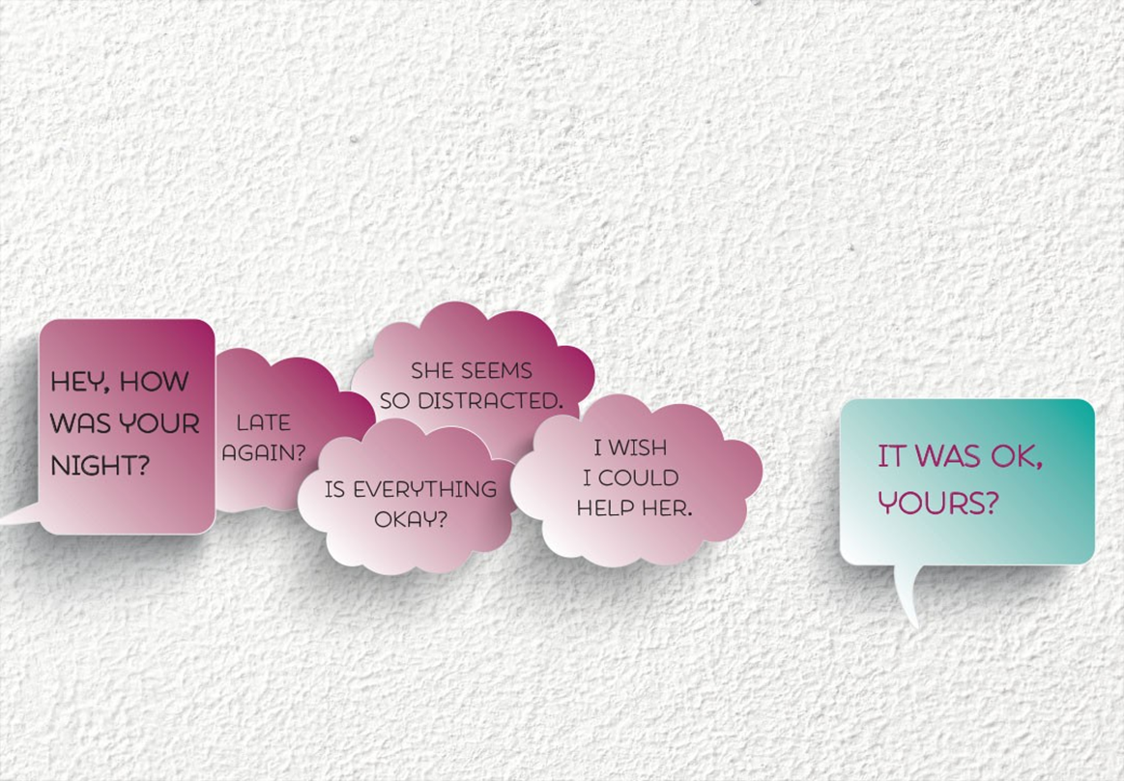
http://canadianlabour.ca/issues-research/domestic-violence-work
Domestic violence at work resource centre

Slide 54

Contact
Barb MacQuarrie
Community Director
Centre for Research & Education on Violence against Women & Children
Faculty of Education, Western University
Room 1118, 1137 Western Road
London, ON N6H 1X7
Tel. 519.661.4023
bmacquar@uwo.ca

