Slide 1
Workplace Violence
Simple Steps to Assisting the Victim
Angela Arsenio
Victim Services Niagara

Slide 2
Guiding Principles
Violence and Trauma
Critical Incident Stress
Validation
Support
Safety Planning
Self-Care

Slide 3
“The ordinary response to atrocities is to banish them…certain violations of the social compact are too terrible to utter aloud ~ this is the meaning of the word unspeakable”
Judith Herman

Slide 4
Trauma is hard to speak
Hard to see
Hard to hear

Slide 5
Reactions to Violence
The way we manage acts of violence in the workplace (or outside it) is dependent on several factors:
1. Biology how are you “wired”?
2. Previous experiences of abuse or violence history of childhood abuse or chronic exposure to acts of violence in work
3. Personal coping style resilience and self-care practices
4. Current life circumstances age, life cycle
5. Values and beliefs perception and meaning making

Slide 6
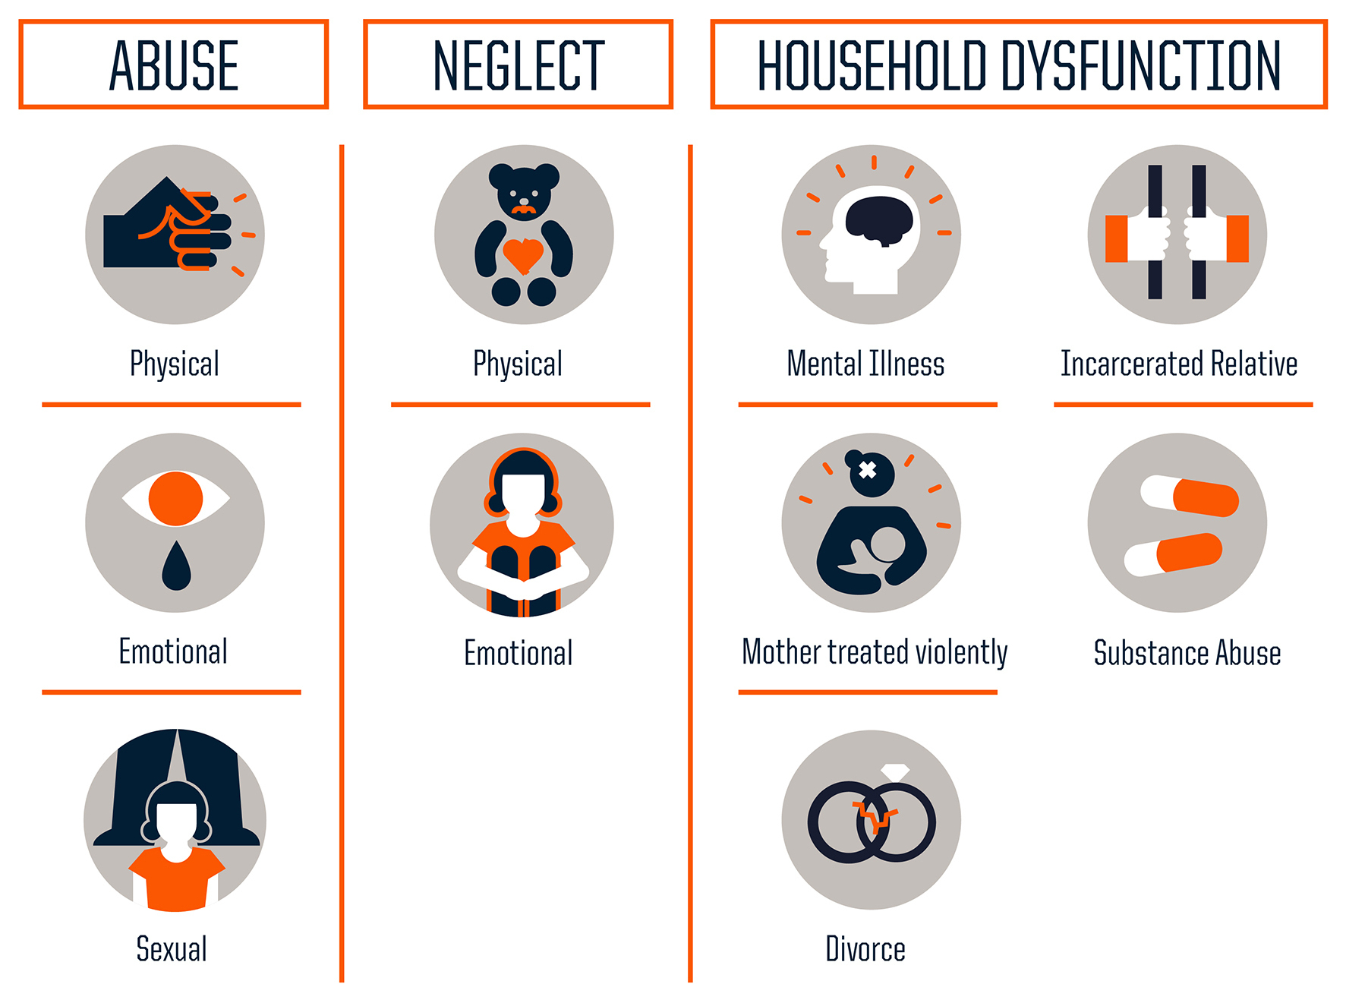

Slide 7
Impact of Violence
One time traumatic event will have different effects than ongoing acts of violence or exposure to high pressure, potentially dangerous employment
Trauma has significant impact on the brain and how we process events
The traumatized brain makes profound biological adaptions
PTSD happens when the brain’s own alarm system cannot re-set itself and continues to signal danger to the body even when safety is restored

Slide 8
Critical Incident Stress
When you have experienced a traumatic event or an emotionally charged event, it is referred to as a Critical Incident
This causes normal stress responses. The level of affect is very personal and dependent on many factors.
Can occur at the scene, within hours, days or even weeks
You can experience a variety of symptoms or none at all

Slide 9
PHYSICAL | COGNITIVE | EMOTIONAL | BEHAVIOURIAL
Chills Fatigue Nausea/vomiting Weakness Fainting Dizziness Profuse sweating Difficulty breathing | Confusion Nightmares Intrusive images Poor problem solving Disorientation of time, people, place or things Heightened or lowered alertness Blaming | Fear Guilt Grief Panic Denial Anxiety Depression Anger Agitation | Isolation Inability to rest Erratic Movements Loss/increase of appetite Change in speech patterns Increased alcohol consumption

Slide 10
The Power of Presence
Move victim to a quiet location away from incident
Speak softly and slowly
Establish comfort (offer water, blanket etc.)
Encourage periods of physical movement alternating with rest to address physical reactions
Don’t say, “you are lucky it wasn’t worse” or “I know how you feel”
If possible, do not immediately pressure for details of the event. Focus on feelings and physical needs
Do not question feelings-”You shouldn’t feel xxxx” … how someone feels cannot be wrong

Slide 11
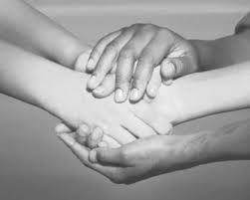
Validation
Find wisdom and value in the victim’s responses
Remind them that they are normal and having a normal reaction
Encourage the sharing of feelings with a safe person, such as close co-workers or friends as a way to defuse
Identify the strengths demonstrated by victim and help reinforce

Slide 12
Support
Provide information about resources in the community
Can include EAP program, 24 hour crisis lines and dispatching crisis teams if possible
Allow for time away if possible and desirable
Connection to family and friends

Slide 13
Safety Planning
Feeling safe is a critical component of moving forward for victims
Safety includes both the physical and emotional
Often, incidences of violence affect our feelings about our community and our sense of personal safety living in this world
Workplace safety is very dependent on the type of work, location of employment and types of systems and supports in place
Victim Services offers comprehensive safety planning which considers your safety in your home, on the street, and in your workplace

Slide 14
Some thoughts on workplace safety
Know your vulnerabilities!
Avoid isolated staircases and elevators. If you are assaulted in an elevator, push as many buttons as possible
Avoid working alone. Whenever possible, work in pairs. High risk activities such as child apprehensions should be well planned and executed with police services
Carry a whistle or other panic button device
Complete a self-defence course if your workplace does not provide any kind of de-escalation training
Improved client assessment tools of clients and reporting systems
Risk assessment training
Supportive reporting system for concerns about safety and high risk clients
Code word system used by co-workers
Specific protocols for screening telephone calls and visitors to your workplace

Slide 16
Emotional Safety-Self Care
Compassion Fatigue | Vicarious Trauma | Burnout
Cumulative effect but can occur suddenly | Cumulative effect, slowly shifting views | Occurs over a long period
Emotional and physical erosion that takes place when helpers are unable to refuel and regenerate | Fundamental beliefs about the world are altered and possibly damaged by being repeatedly exposed to traumatic material | Result of emotional exhaustion and can be remedied through rest and making changes

Slide 17
Post Action Support
After each call, Crisis Responders debrief from each call as a team
It is a practice to reduce the effects of vicarious trauma, cumulative stress and any negative self-judgement
The team asks each other a series of questions, including:
how did it go?
what themes emerged?
what did you say that you wish you hadn’t?
what was one thing your teammate did that made the process go well?

Slide 18
Balance & Rest
Self-care can look like a lot of different things
Cultivate meaningful relationships
Enjoy nature
Steward our bodies through physical exercise
Develop our minds and imaginations
Quiet time
Develop rituals to transition between work and home

Slide 19
Innovative Tools and Training
ProActive Resolutions~ Foundational Violence Risk Assessment and Management Workshop (5 day training)
Safe Guard~Therapeutic Crisis Intervention (2 day)
Critical Incident Stress Management (2 day)
Threads of Life~Association for Workplace Tragedy Family Support

Slide 20
References
Lori Haskell (2016). Violence, Victimization and Trauma. Presentation for Victim Services of York
Grady Bray (2016). Crisis Stress and Peer Support Training.
Victim Services Niagara Training Manual (2015)

